Slide 1
Welcome to Live Lecture
Week 7 Agenda
Moderator: Gina Cooper
Files
File objects
CSV files
Questions

Slide 2
Why Files?
Most data will come from other sources than the keyboard for applications
Data files can be processed, manipulated or used as input
Store data in a file rather than memory so that it persists

Slide 3
Readers and Writers (adapters)
Byte Streams
FileStream class
Files and Directories
(storage medium)
Your application
StreamReader class
StreamWriter class
File class
Directory class
Path class
FileInfo class
DirectoryInfo class

Slide 4
System.IO Namespace
Provides basic file and directory support classes
Contains types that enable you to read and write files and data streams
Many of the types or classes defined as part of the System.IO namespace are designed around streams
Include system.IO namespace for processing, modifying, accessing, and moving files and directories
File, FileInfo, Directory, and DirectoryInfo classes are Utility classes
Utility classes allow you to manipulate files and directory structures
Aid in copying, moving, renaming, creating, opening, deleting, and appending files

Slide 5
File Class
File.Exists(filename) Note: before attempting to open a file, call File.Exists()
File.Copy (sourceFile, targetFile)
File.GetLastAccessTime(filename) = Date and time file was accessed
File.GetCreationTime(filename) = Date and time file was cresated
File.GetLastWriteTime(filename) = Date and time file was last written to
File.Create(filename) = Creates file
File.Delete(filename) = Deletes file
File.AppendAllText(filename) = appends text to an existing file

Slide 6
Example
Create new Windows Forms Application
Add a button named Create file and double click for the button click event handler
Add: using System.IO;
if (File.Exists("cis170.txt"))
{
MessageBox.Show("File cis170 Exists ");
}
else
{
FileStream fs = File.Create("cis170.txt");
MessageBox.Show("File cis170 created ");
MessageBox.Show("File Creation Time " + File.GetCreationTime("cis170.txt"));
}
File -> Save All
Run program. You will see the form. Close immediately.
cis170.txt will be created in the ProjectName\bin\Debug folder

Slide 7
To Create the File in a different drive (such as USB)
Replace E with your usb drive
if (File.Exists(@"E:\cis170.txt"))
{
MessageBox.Show("File cis170 Exists ");
}
else
{
FileStream fs = File.Create(@"E:\cis170.txt");
MessageBox.Show("File cis170 created ");
}

Slide 8
Directory class
Directory.GetCurrentDirectory(); = name and path of current directory
Directory.GetParent (Directory.GetCurrentDirectory());
Directory.Exists (Directory.GetCurrentDirectory()); = check to see if the directory is actually on your computer
Directory.Delete (Directory.GetCurrentDirectory()); = delete specified directory. This exact code will throw an exception since you can't delete the current directory
Using DirectoryInfo can give you information for each file in a directory

Slide 9
Directory class
Create another button named Print Directory. In the button click event handler add code to print all files in the current directory:
string dir = Directory.GetCurrentDirectory();
string msg = "";
msg += dir;
string[ ] files = Directory.GetFiles(dir);
foreach (string val in files)
{
msg += val;
msg += "\n";
}
MessageBox.Show(msg);

Slide 10
Writing Files
C# uses file streams to deal with stored data
Stream = chunk of data
IO.Stream = used for byte-level data
IO.StreamReader = reading data in text format (we will use this – has a ReadLine() method like Console)
IO.StreamWriter = writing data in text format (we will use this – has a WriteLine() method like Console)

Slide 11
Writing and Reading files
Always use try…catch blocks to check for exceptions
When creating StreamWriting a boolean value indicates whether the file should be appended to or overwritten
StreamWriter outfile = new StreamWriter("cis170.txt", true) = opens the file for appending
StreamWriter outfile = new StreamWriter("cis170.txt") = opens the file for overwriting

Slide 12

Avoiding Run Time Errors
Open a file before writing to it
Close a file after using it
Enclose file access statements in a try…catch block

Slide 13
Exercise
We want to add a text box to our form and have the user type something. Then it will be written out to the cis170 file.
Below the class definition we need to create the StreamWriter to make it a global variable:
public partial class Form1 : Form
{
public StreamWriter outfile;
We will create a textbox (name: txtMessage), label, and button on the form
Then we will create a label to instruct the user to enter their favorite topic of CIS170!
Enter code in the Form_Load() to construct the StreamWriter object
Enter code in the button_click to write the line to the file
Enter code in the Form_Closing() to close the StreamWriter
(code follows)
Check your file – is the text there?

Slide 14
Creating the StreamWriter
Code in form_load
try
{
outfile = new StreamWriter("cis170.txt");
}
catch (DirectoryNotFoundException exc)
{
MessageBox.Show(exc.Message);
}
catch (System.IO.IOException err)
{
MessageBox.Show(err.Message);
}

Slide 15
Code in Button Click
try
{
outfile.WriteLine(txtMessage.Text);
txtMessage.Text = "";
}
catch (System.IO.IOException exc)
{
MessageBox.Show(exc.Message);
}

Slide 16
Code in Form_Closing
Access Form_closing using the lightning bolt on the properties window. Double click FormClosing to enter the code:
try
{
outfile.Close();
}
catch
{
MessageBox.Show("File did not close properly");
}

Slide 17
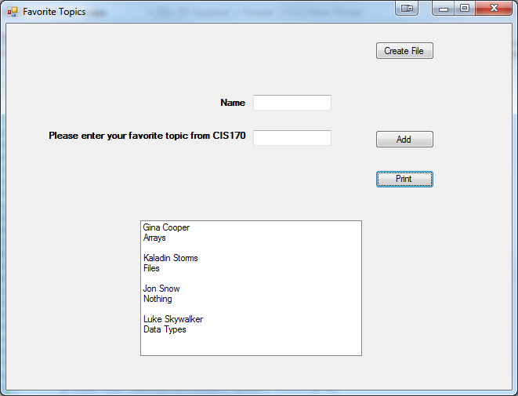
Scenario
Accept names and favorite topics from CIS170 from the user. Then write to a text file. Then read the records from the text file and display them. Use a buttons to allow the user to append records to the file or display records
Use a listbox to display records
Notes:
using System;
using System.Collections.Generic;
using System.ComponentModel;
using System.Data;
using System.Drawing;
using System.Linq;
using System.Text;
using System.Threading.Tasks;
using System.Windows.Forms;
using System.IO;
namespace TestGUI
{
public partial class frmFavoriteTopics : Form
{
public StreamReader infile;
public StreamWriter outfile;
public frmFavoriteTopics()
{
InitializeComponent();
}
private void btnAdd_Click_1(object sender, EventArgs e)
{
if (File.Exists("topics.txt"))
{
try
{
outfile = new StreamWriter("topics.txt", true);
outfile.WriteLine(txtName.Text);
outfile.WriteLine(txtTopic.Text);
outfile.WriteLine();
outfile.Close();
txtName.Text = "";
txtTopic.Text = "";
}
catch (DirectoryNotFoundException exc)
{
lstTopics.Items.Add(exc.Message);
}
}
}
private void btnPrintDirectory_Click(object sender, EventArgs e)
{
string inValue;
lstTopics.Items.Clear();
try
{
infile = new StreamReader("topics.txt");
while ((inValue = infile.ReadLine()) != null)
{
lstTopics.Items.Add(inValue);
}
infile.Close();
}
catch (System.IO.IOException exc)
{
lstTopics.Items.Add(exc);
}
}
private void btnCreate_Click_1(object sender, EventArgs e)
{
if (!File.Exists("topics.txt"))
{
outfile = new StreamWriter("topics.txt");
outfile.Close();
}
}
}
}

Slide 18

Key concepts
Files
Directories
Directory info
Try….catch block

